Slide 1

多媒体系统导论——图形和图像的数据表现
授课教师：张小燕
Email：xyzhang15@szu.edu.cn

Slide 2
Outline of Lecture 02
Fundamentals of image data representation
Standard image
Gray-level image
Bitmap and bitplane（位平面）
Color image
24-bit color image and 8-bit color image
Histogram and color lookup tables
Some popular image file format
Some calculations
How to calculate the size of image?
How to transform 24 bit color image to 8 bit color image?
How to calculate histogram?
How does dithering work?

Slide 3
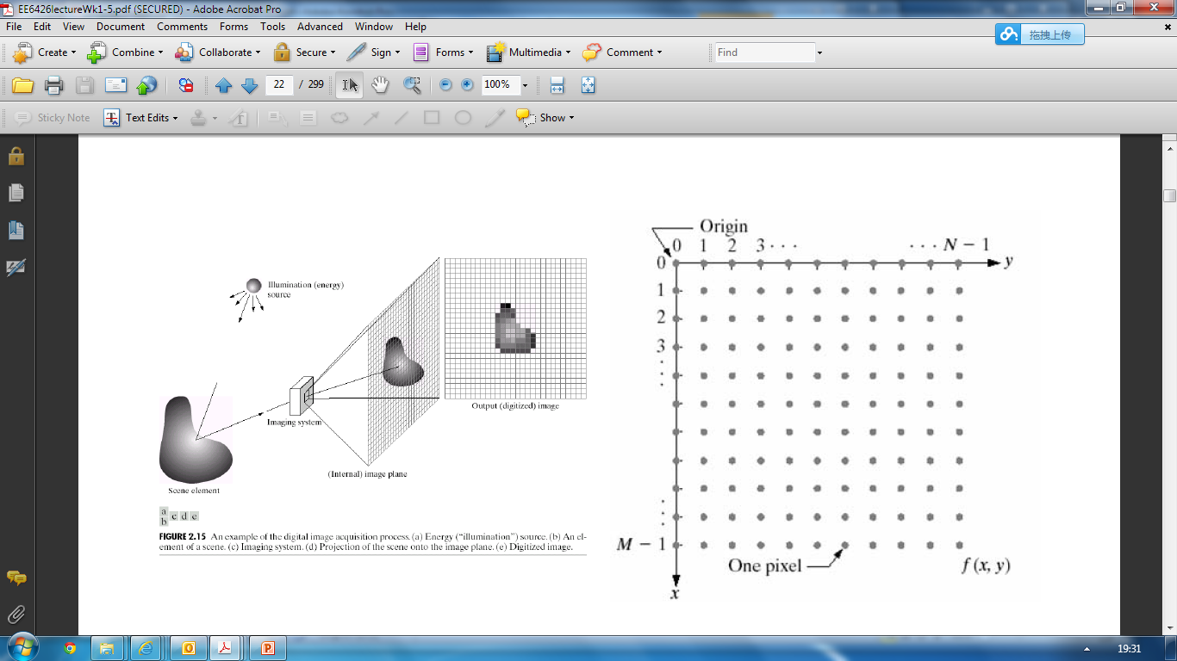
Fundamentals of Image Data Representation
Images

Slide 4
Fundamentals of Image Data Representation
Images consist of pixels
Pixel: picture element
The smallest discrete component of an image on the screen
Image resolution
The number of pixels in a digital image
Standard images
Illustrate algorithms and compare the performance
Lena: for gray-level image generally
Baboon（狒狒）: for color image generally

Slide 5
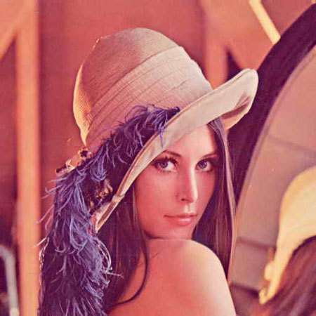
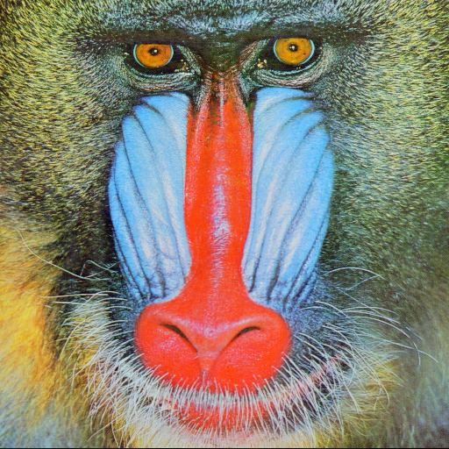
Standard Images
Lena:
Image Resolution is 256 * 256
Baboon:
Image Resolution is 512* 512

Slide 6
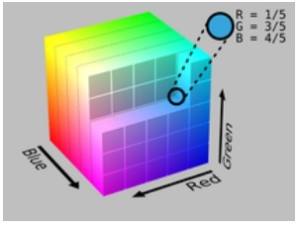
Fundamentals of Image Data Representation
R
G
B

Slide 7
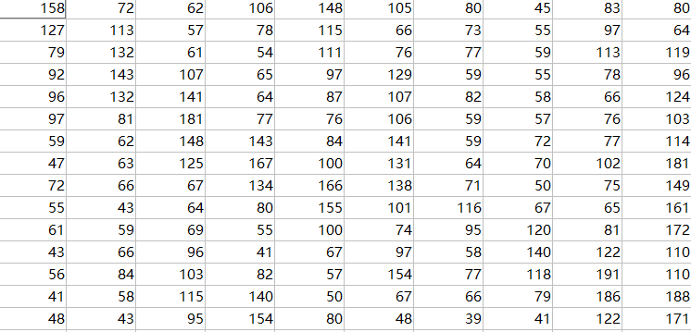
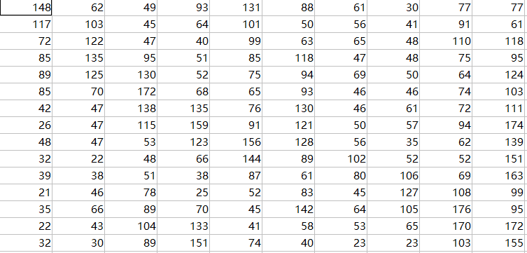
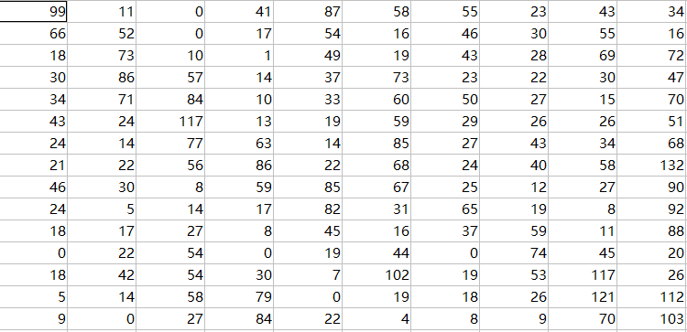
Fundamentals of Image Data Representation
Matlab，imread(filename) 读取 uint8格式的图像(取值范围0 -255)
See demo1RGB
列
行
R
G
B

Slide 8
Outline of Lecture 02
Fundamentals of image data representation
Standard image
Gray-level image
Bitmap and bitplane
Color image
24-bit color image and 8-bit color image
Histogram and color lookup tables
Some popular image file format
Some calculations
How to calculate the size of image?
How to transform 24 bit color image to 8 bit color image?
How to calculate histogram?
How does dithering work?

Slide 9
Gray-Level Image （灰度图像）
Image is represented using luminance（亮度） information only
8-bit gray-level image
Each pixel has a gray value between 0 and 255
Matlab code ： rgb2gray(I)

Slide 10
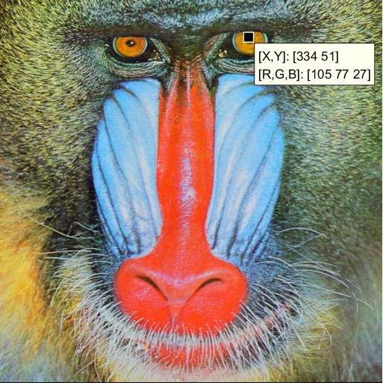
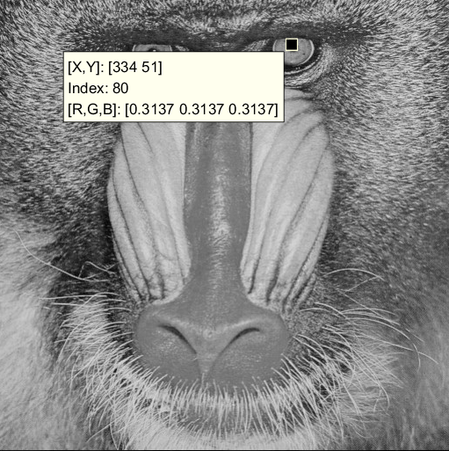
Gray-Level Image（灰度图像）
512x512的24位彩色图像转成8位灰度图像后，未压缩时数据量关系？
a. 灰度图像和彩色图像大小一样
b. 灰度图像是彩色图像数据量大小的一半
c. 灰度图像是彩色图像数据量大小的三分之一

Slide 11
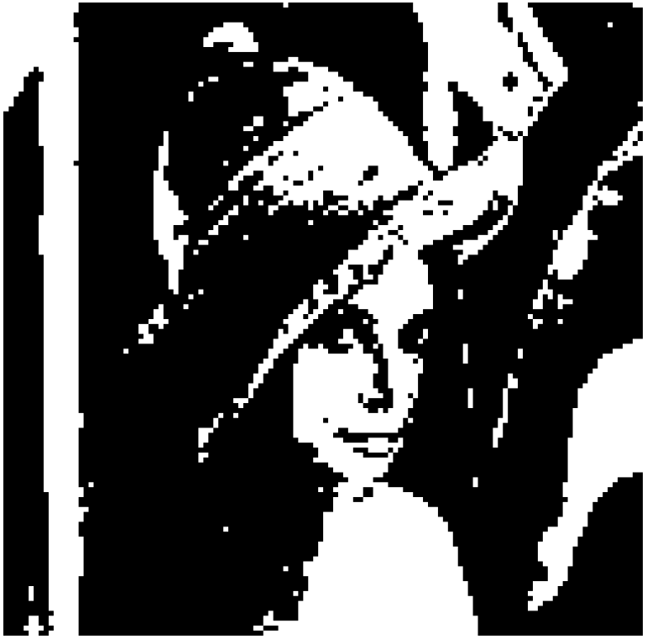
Binary Image （二值图像）
Each pixel is stored as a single bit 0/1.
Also referred as 1-bit image
Use for the pictures containing simple graphics or text

Slide 12

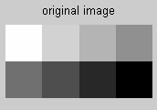
Bitmap of Gray-level Image
The two-dimensional array of pixel values that represent the images/graphics
Notes:
表示图像或者图形的二维数组就称为位图

Slide 13
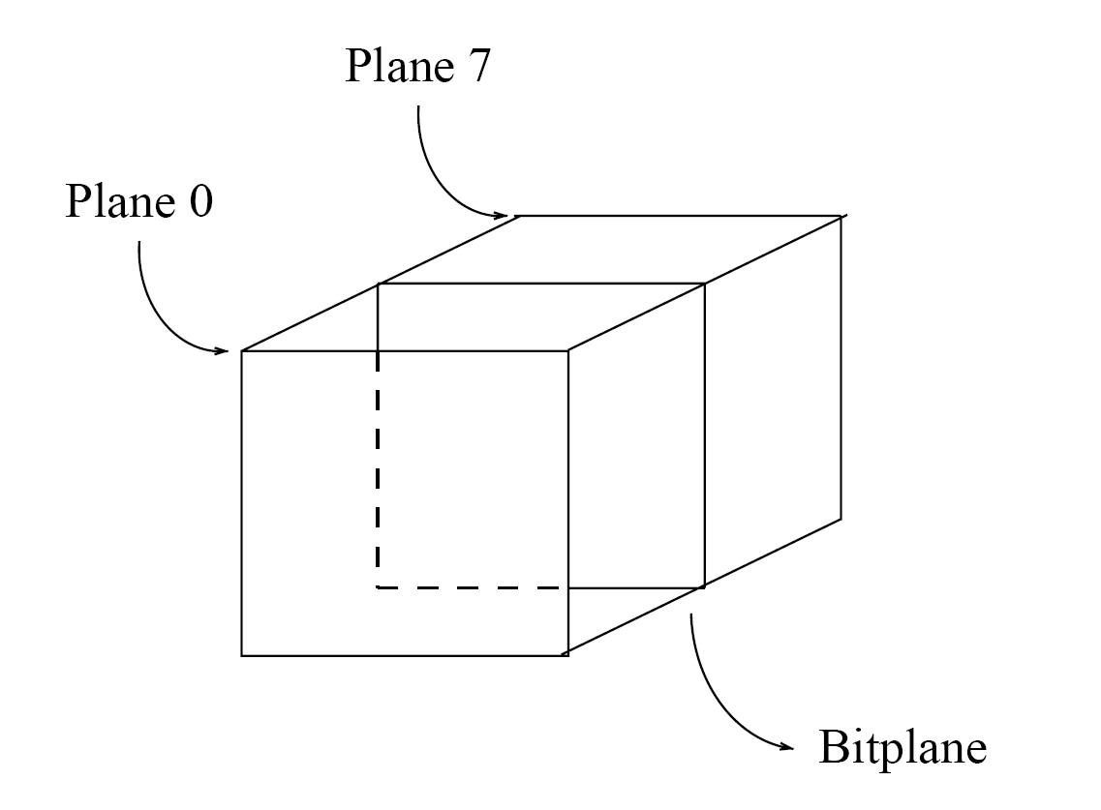
Bitplane （位平面） of 8-bit image
Bitplanes
Consider the 8-bit image as a set of 1-bit bitplanes
Each plane consists of a 1-bit representation of the image
Notes:
每个像素由8位二进制组成，每一位单独抽出来存在一个平面称为位平面。

Slide 14
Bitplane （位平面） of 8-bit image
20 | 30 | 120
255 | 150 | 10
128 | 80 | 230
00010100 | 00011110 | 01111000
11111111 | 10010110 | 00001010
10000000 | 01010000 | 11100110
Gray Image
Binary
0 | 0 | 0
1 | 0 | 0
0 | 0 | 0
0 | 1 | 0
1 | 1 | 1
0 | 0 | 1
1 | 1 | 0
1 | 1 | 0
0 | 0 | 1
0 | 0 | 0
1 | 1 | 0
1 | 0 | 1
。。。
Plane 0
Plane 1
Plane 2
Plane 7

Slide 15
Bitplane （位平面） of 8-bit image
20 | 30 | 120
255 | 150 | 10
128 | 80 | 230
00010100 | 00011110 | 01111000
11111111 | 10010110 | 00001010
10000000 | 01010000 | 11100110
Gray Image
Binary
0 | 0 | 0
1 | 0 | 0
0 | 0 | 0
0 | 1 | 0
1 | 1 | 1
0 | 0 | 1
1 | 1 | 0
1 | 1 | 0
0 | 0 | 1
0 | 0 | 0
1 | 1 | 0
1 | 0 | 1
。。。
Plane 0
Plane 1
Plane 2
Plane 7

Slide 16
Bitplane （位平面） of 8-bit image
20 | 30 | 120
255 | 150 | 10
128 | 80 | 230
00010100 | 00011110 | 01111000
11111111 | 10010110 | 00001010
10000000 | 01010000 | 11100110
Gray Image
Binary
0 | 0 | 0
1 | 0 | 0
0 | 0 | 0
0 | 1 | 0
1 | 1 | 1
0 | 0 | 1
1 | 1 | 0
1 | 1 | 0
0 | 0 | 1
0 | 0 | 0
1 | 1 | 0
1 | 0 | 1
。。。
Plane 0
Plane 1
Plane 2
Plane 7

Slide 17
Demo of gray image
Demo2
see demo2rgb2gray
Show color image, gray image, bit image
Convert color to gray and bit images
Demo3
See demo3bitplane
Show bitplane

Slide 18
Outline of Lecture 02
Fundamentals of image data representation
Standard image
Gray-level image
Bitmap and bitplane
Color image
24-bit color image and 8-bit color image
Histogram and color lookup tables
Some popular image file format
Some calculations
How to calculate the size of image?
How to transform 24 bit color image to 8 bit color image?
How to calculate histogram?
How does dithering work?

Slide 19
24-bit Color Image of RGB Model
R
8-bit
G
8-bit
B
8-bit

Slide 20
24-bit Color Image(真彩色)
Each pixel is represented by three Bytes, usually RGB
Supports 256*256*256, totally 16.8-million possible combined color
Storage: for image resolution of 640*480, needs 900KB (640*480*3/1024)
Some 24-bit color images are stored as 32-bit image
Extra byte of data for special-effect information

Slide 21
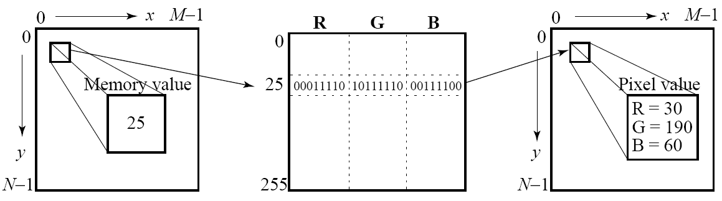
Color Lookup Tables (颜色查找表)
Many systems can make use of 8 bits of color in producing a screen image（伪彩色）.
Such image files use the concept of a lookup table（查找表）to store color information.
Use index（索引） or code value（编码值） instead of 24-bit color information for each pixel
Color lookup the table works well for small combinations

Slide 22
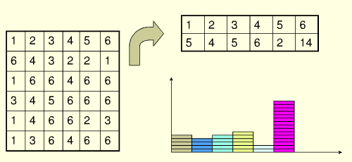
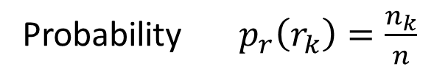
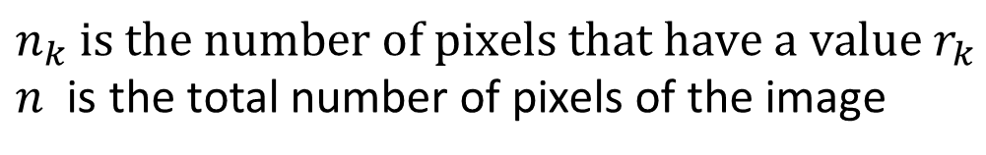
Image Histogram（直方图）
A histogram is an accurate representation of the distribution of numerical data
See demo4Hist
Image Histogram
Probability$p_{r}\left(r_{k}\right)=\frac{n_{k}}{n}$
$$n_{k} is the number of pixels that have a value r_{k}$$
$n$ is the total number of pixels of the image

Slide 23
8-bit Color Image
Divide the RGB cube into equal slides in each dimension
R: 3-bit; G: 3-bit; B: 2-bit;
Edge artifacts （边缘伪影）
See demo5RGBto8
Based image histogram, select 256 most popular colors
24-bit颜色图
8-bit颜色图

Slide 24
Outline of Lecture 02
Fundamentals of image data representation
Standard image
Gray-level image
Bitmap and bitplane
Color image
24-bit color image and 8-bit color image
Histogram and color lookup tables
Some popular image file format
Some calculations
How to calculate the size of image?
How to transform 24 bit color image to 8 bit color image?
How to calculate histogram?
How does dithering work?

Slide 25
Some Popular Image File Formats
BMP
BitMap
Mainly use RGB color model
Gif
Graphics Interchange Format
Important formats because of its historical connection to the WWW and HTML
PDF
Portable Document Format
Include compression
JPEG
Joint Photographic Experts Group
Currently the most important common file format

Slide 26
Outline of Lecture 02
Fundamentals of image data representation
Standard image
Gray-level image
Bitmap and bitplane
Color image
24-bit color image and 8-bit color image
Histogram and color lookup tables
Some popular image file format
Some calculations
How to calculate the size of image?
How to transform 24 bit color image to 8 bit color image?
How to calculate histogram?
How does dithering work?

Slide 27
How to Calculate the Size of Image
8 bit Gray image
Image resolution: 640*480
Bytes
640*480*8 = 2457600b= 2457600 /1024 Kb = 2400Kb
640*480 = 307200B = 307200/1024 KB= 300KB
24 bit color image
Bytes
640*480*24 = 7372800b = 7372800/1024 Kb = 7200Kb
640*480*3 = 921600B =921600/1024KB = 900KB

Slide 28
How to Transform 24-bit to 8-bit?
Divide the RGB cube into equal slides in each dimension
R: 3-bit (0-7); G: 3-bit (0-7); B: 2-bit (0-3);
See demo5RGBto8
24-bit颜色图
8-bit颜色图

Slide 29
How to Calculate Histogram?
Histogram
representation of the distribution of numerical data
Help hist, imhist in Matlab
N = hist(Y) bins the elements of Y into 10 equally spaced containers and returns the number of elements in each container. Y is a vector.
imhist displays a histogram for the intensity image
See demo4Hist

Slide 30

How Does Dithering (抖动) Work?
用只有黑墨的打印机，怎么打印出一个灰度图像？
Basic strategy of dithering work
Trade intensity resolution for spatial resolution
Dithering
To calculate patterns （图案）of dots such that values from 0 to 255 correspond to patterns that are more and more filled at darker pixel values, for printing on a 1-bit printer

Slide 31
Dithering Example
Halftone printing （网板打印）
Replace a pixel value by a larger pattern, say 2 × 2 or 4 × 4
Rule: If the intensity is > the dither matrix entry then print an on dot at that entry location: replace each pixel by an n × n matrix of dots
Dithering matrix
0 | 8 | 2 | 10
12 | 4 | 14 | 6
3 | 11 | 1 | 9
15 | 7 | 13 | 5
In the printing color space, 0 represents white, 255 represents black. We can first re-map image values in 0…255 into the new range 0..4 by (integer) dividing by 256/5. Then, e.g., if the pixel value is 0 we print nothing, in a 2 × 2 area of printer output. But if the pixel value is 4 we print all four dots.

Slide 32
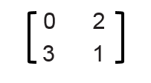
Dithering Example
0 | 0 | 1 | 0 | 1 | 0
0 | 0 | 0 | 0 | 0 | 1
1 | 1 | 1 | 1 | 0 | 0
0 | 1 | 1 | 1 | 0 | 0
1 | 0 | 1 | 0 | 1 | 1
0 | 0 | 0 | 1 | 0 | 1
1 | 1 | 0 | 0 | 1 | 0
1 | 1 | 0 | 0 | 0 | 0
0 | 1 | 2
3 | 4 | 0
1 | 2 | 3
4 | 0 | 1

Slide 33
Dithering Example
0 1 2 3 4
0 | 0 | 1 | 0 | 1 | 0
0 | 0 | 0 | 0 | 0 | 1
1 | 1 | 1 | 1 | 0 | 0
0 | 1 | 1 | 1 | 0 | 0
1 | 0 | 1 | 0 | 1 | 1
0 | 0 | 0 | 1 | 0 | 1
1 | 1 | 0 | 0 | 1 | 0
1 | 1 | 0 | 0 | 0 | 0
0 | 1 | 2
3 | 4 | 0
1 | 2 | 3
4 | 0 | 1
Note that for a dithered image, since replacing each pixel by a 4 × 4 array of dots, makes an image 16 times as large.

Slide 34
Dithering Example
Ordered dither (有序抖动)
turning on the printer output bit for a pixel if the intensity level is greater than the particular matrix element just at that pixel position
0 | 8 | 2 | 10
12 | 4 | 14 | 6
3 | 11 | 1 | 9
15 | 7 | 13 | 5
0 | 1 | 2 | 3 | 4 | 5 | 6 | 7
6 | 7 | 8 | 9 | 10 | 11 | 9 | 10
12 | 13 | 14 | 15 | 16 | 0 | 1 | 2
1 | 2 | 3 | 4 | 5 | 6 | 3 | 4
7 | 8 | 9 | 10 | 11 | 12 | 7 | 8
13 | 14 | 15 | 16 | 0 | 1 | 10 | 11
2 | 3 | 4 | 5 | 6 | 7 | 2 | 12
8 | 9 | 10 | 11 | 12 | 13 | 14 | 15
0 | 0 | 0 | 0 | 1 | 0 | 0 | 0
0 | 1 | 0 | 1 | 0 | 1 | 0 | 1
1 | 1 | 1 | 1 | 1 | 0 | 0 | 0
0 | 0 | 0 | 0 | 0 | 0 | 0 | 0
1 | 0 | 1 | 0 | 1 | 1 | 1 | 0
1 | 1 | 1 | 1 | 0 | 0 | 0 | 1
0 | 0 | 1 | 0 | 1 | 0 | 1 | 1
0 | 1 | 0 | 1 | 0 | 1 | 1 | 1

Slide 35
Algorithm
An algorithm for ordered dither, with n × n dither matrix, is as follows:
See demo6dither
BEGIN
for x = 0 to xmax
for y = 0 to ymax i = x mod n
j = y mod n
// columns
// rows
// I(x, y) is the input, O(x, y) is the output,
//D is the dither matrix. if I(x, y) > D(i, j)
O(x, y) = 1;
else
O(x, y) = 0; END

Slide 36
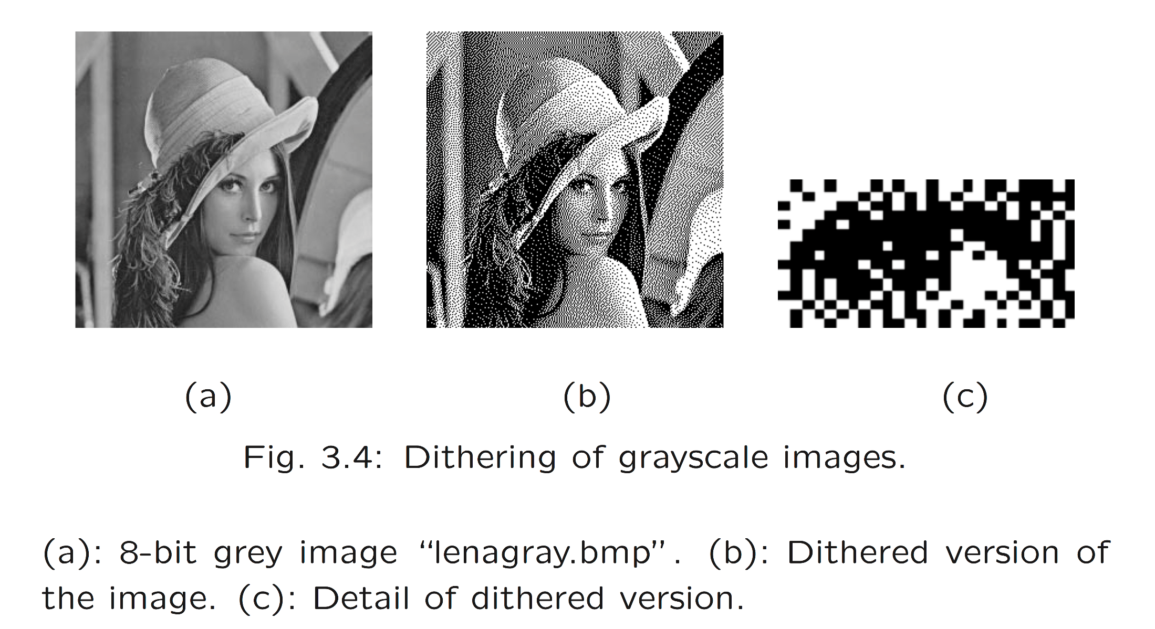
Results

